Slide 1
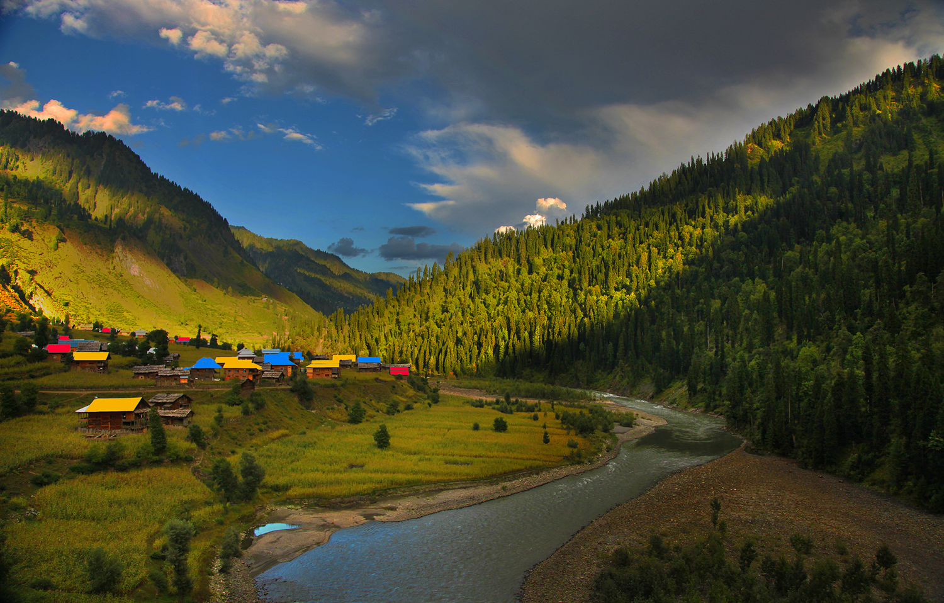
Kashmir The Hidden Paradise

Slide 2
Kashmir Attractions
Muslim Community
Beautiful Scenery
Nice Weather
Winter Sports Facilities
Handy Crafts and Arts

Slide 3
How Technology can help Tourism?
E-commerce
Mobile Apps
Online-Marketing

Slide 4
Our Targets For Promoting Kashmir
Global Market
Kashmir
APAC Market

Slide 5
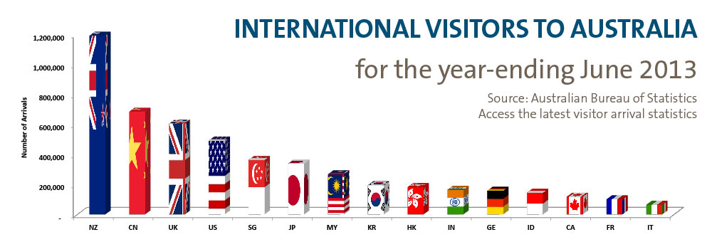
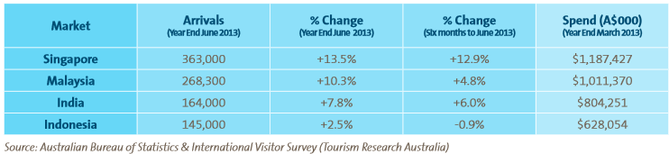
South East Asia’s Great Potential

Slide 6
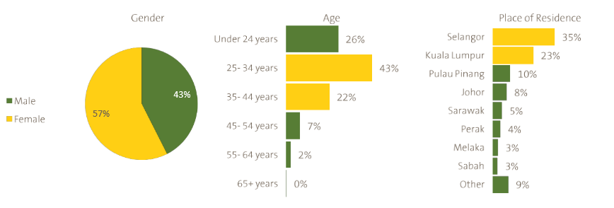
Malaysian Tourists in Australia are mostly young and from
Highly Developed Areas

Slide 7
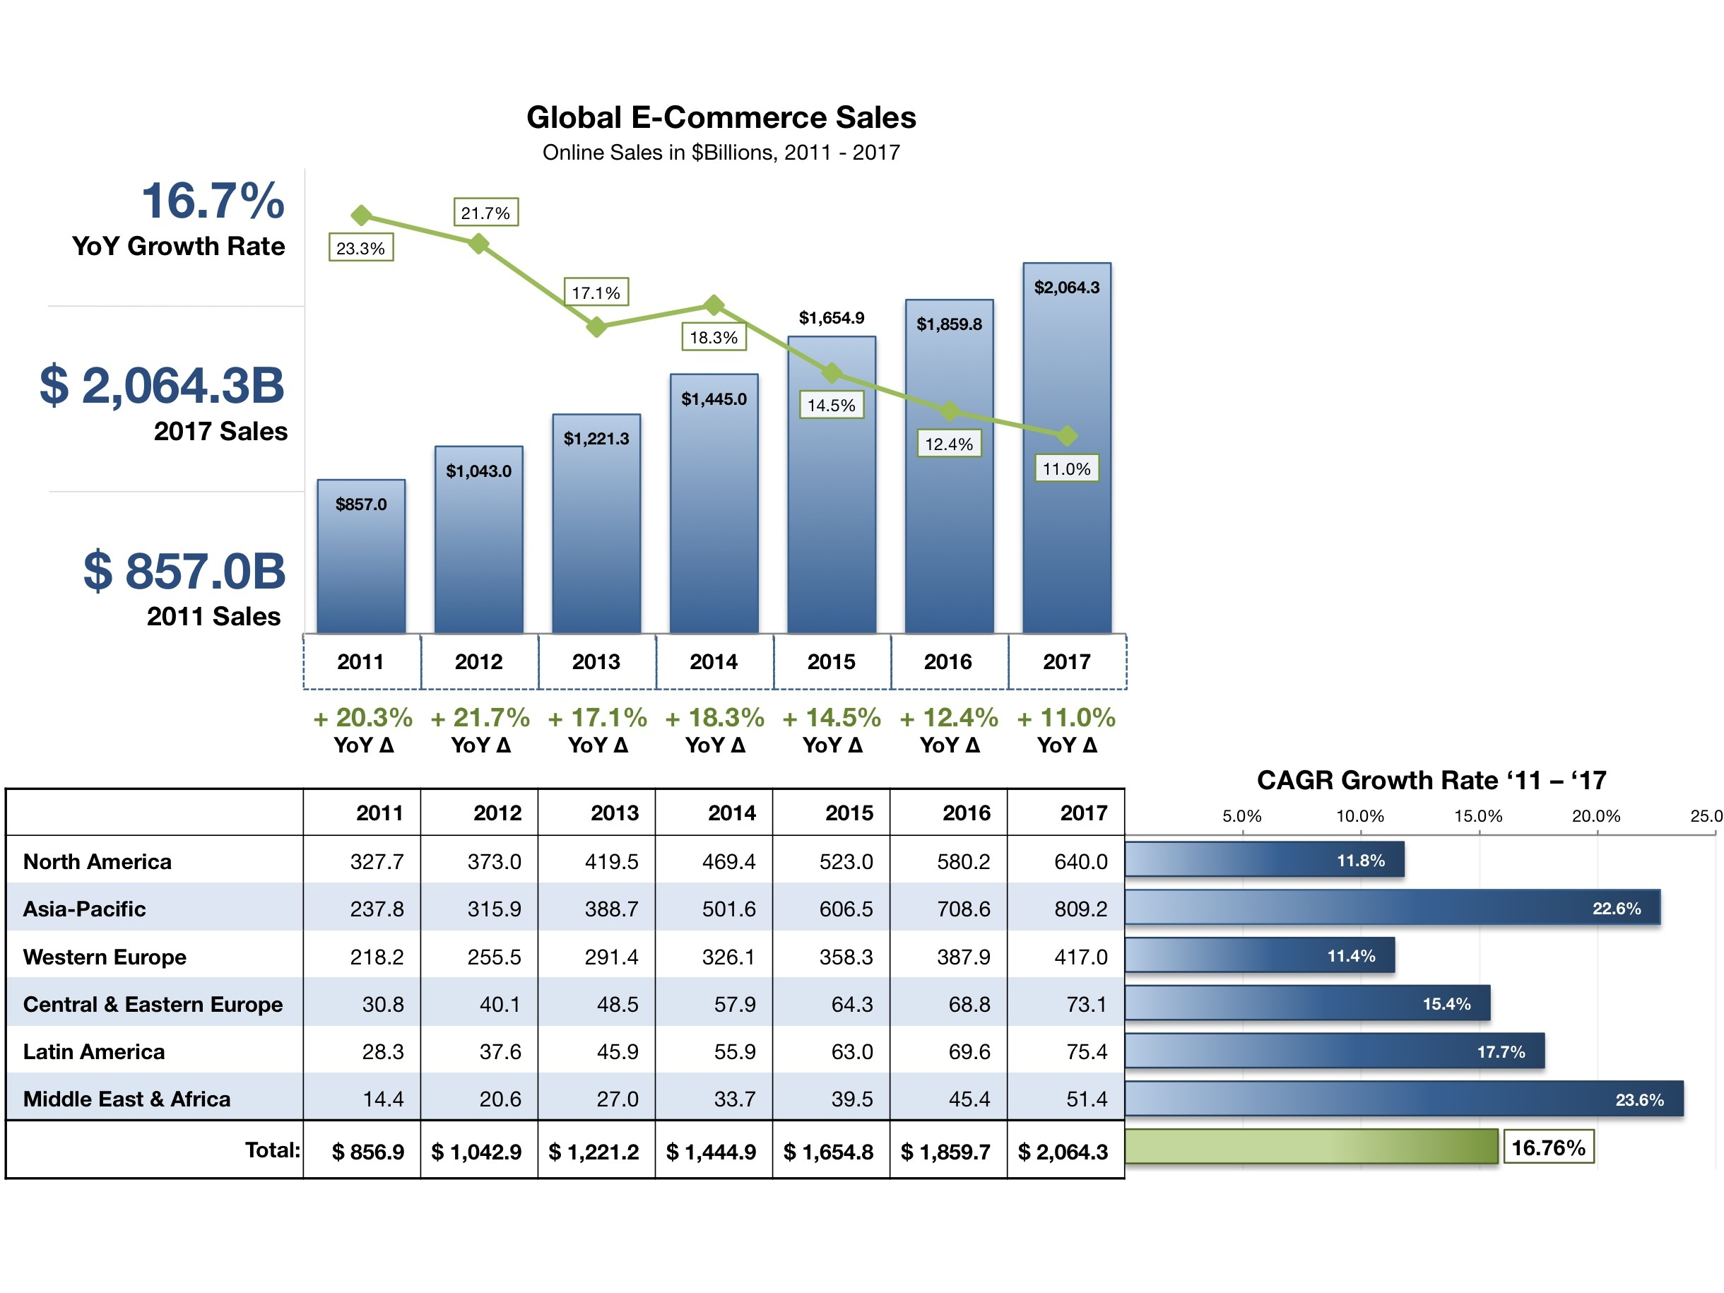
E-commerce market in Asia Pacific

Slide 8
Actions in APAC
A dedicated website for Malaysia, Singapore , Indonesia and Brunai in Bahasa, English and Chinese which be fit to people’s culture and attitude.
Promoting this website and Kashmir attraction physically in Exhibitions
Promoting this website and Kashmir Virtually in Internet.

Slide 9
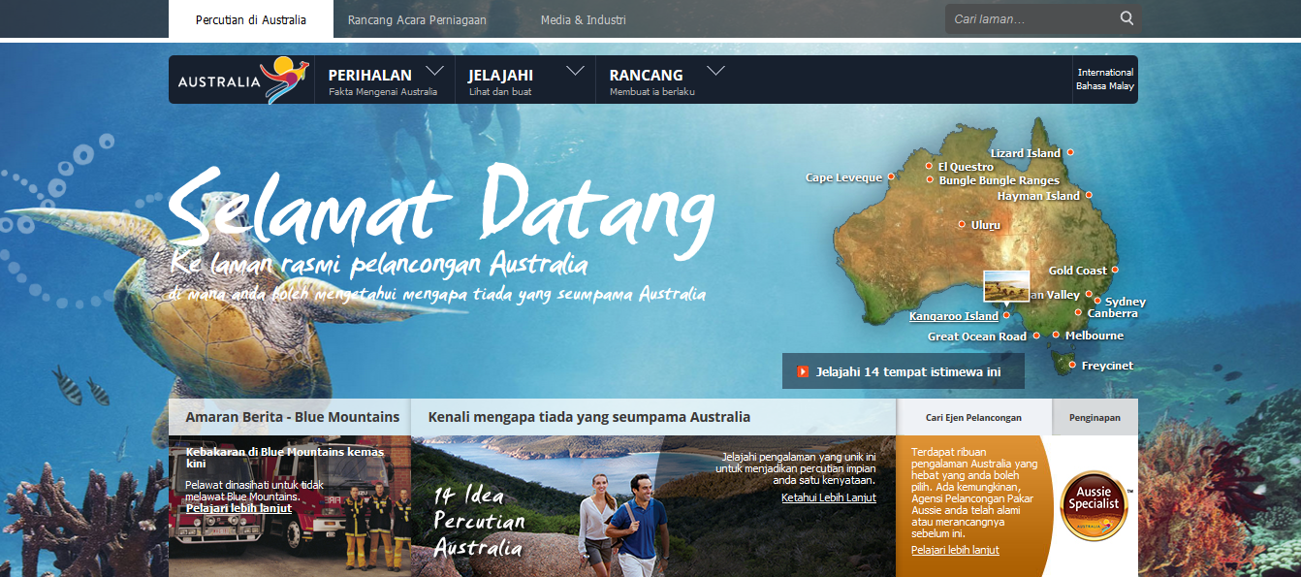
Australia Tourism website for Malaysia

Slide 10
Road Shows in Shopping centers and Hotels
The biggest and the most crowded malls in Kuala Lumpur:
  KLCC
  Pavilion
  Midvalley Mega Mall
  Golden Horses Hotel

Slide 11
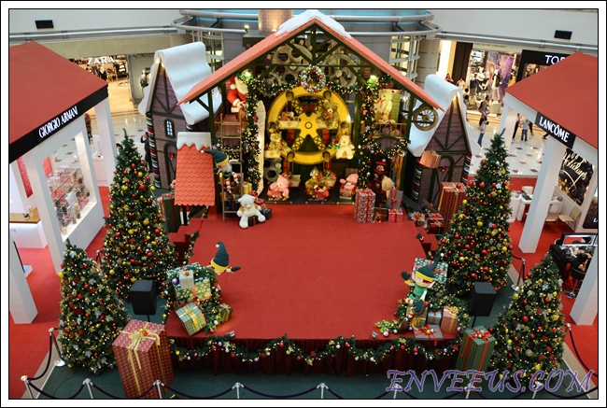
Suria KLCC
Malaysia's premier shopping centre
over 400 shops on 6 floors

Slide 12
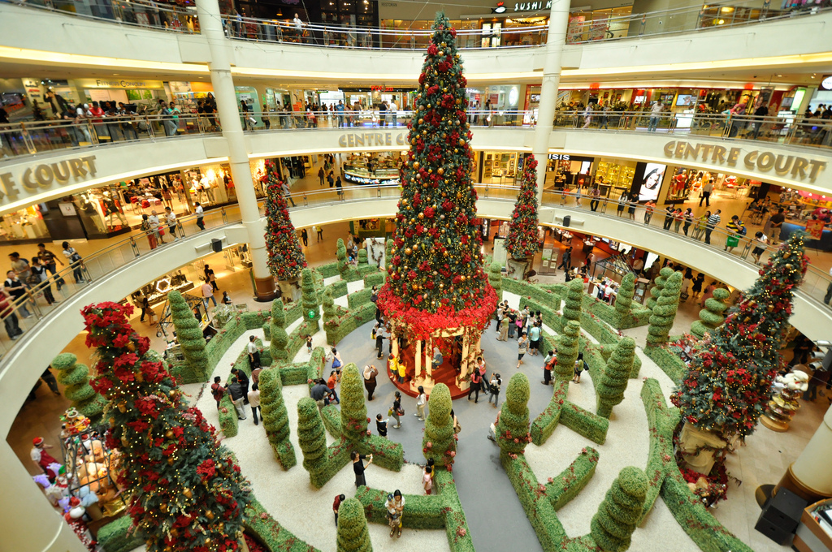
Mid Valley Mega Mall

Slide 13
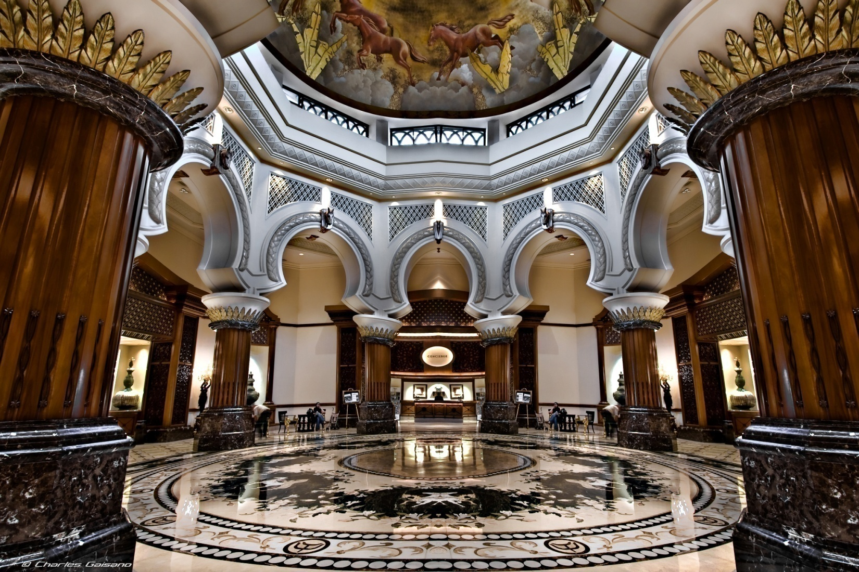
Palace of Golden Horses Hotel

Slide 14
Actions in APAC
Host a reservation system for all facilities in Kashmir including hotels, flights, car rentals, tickets, boats, sports and travel agencies’ tours.
Host Servers, Datacenters, Payment gateway and Security equipments in Malaysia
Welcome packs which promotes Kashmir Mobile App

Slide 15
Actions in Kashmir
A mobile app which is introduce Kashmir interesting places, restaurants and integrated with our reservation system.
The app will design to synchronize very light and less data with datacenters to work efficiently in even low speed Internet
The app can connect to GPS and recommend places near to them.

Slide 16
Actions in Kashmir
This mobile app can be advertised in Airport as a welcome pack
Improving Kashmir Hospitality Infrastructure
Develop a powerful and easy to use CMS for tourism industry
Integrate and train tourism industry in Kashmir to how to take advantage from the reservation System
A support team which will solve technical issues for users

Slide 17
Improving Infrastructure in Kashmir
Providing accommodation match with East Asian’s expectations
Renovating 120 rooms in 6 different places
Upgrade the properties
Hiring exclusive professional staff

Slide 18

World Wide Actions
Enhance the current website Search Engine Optimization
Online Marketing

Slide 19
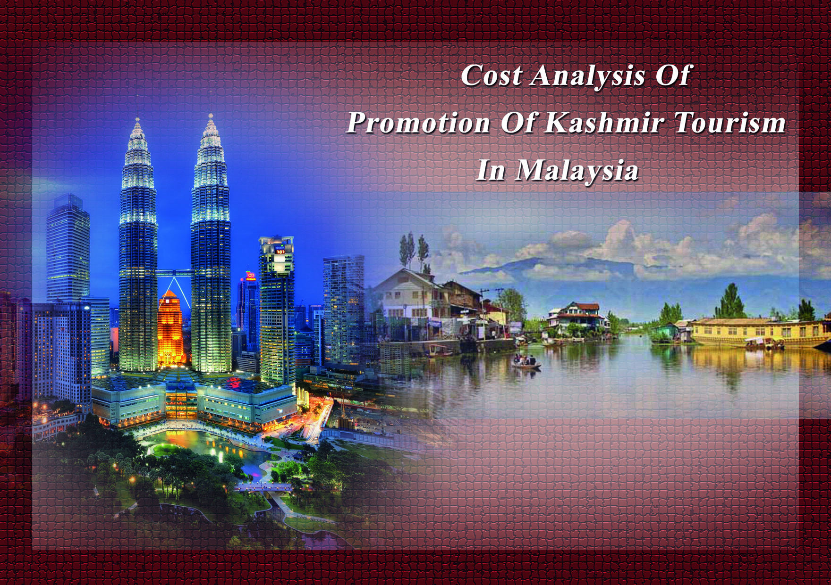

Slide 20
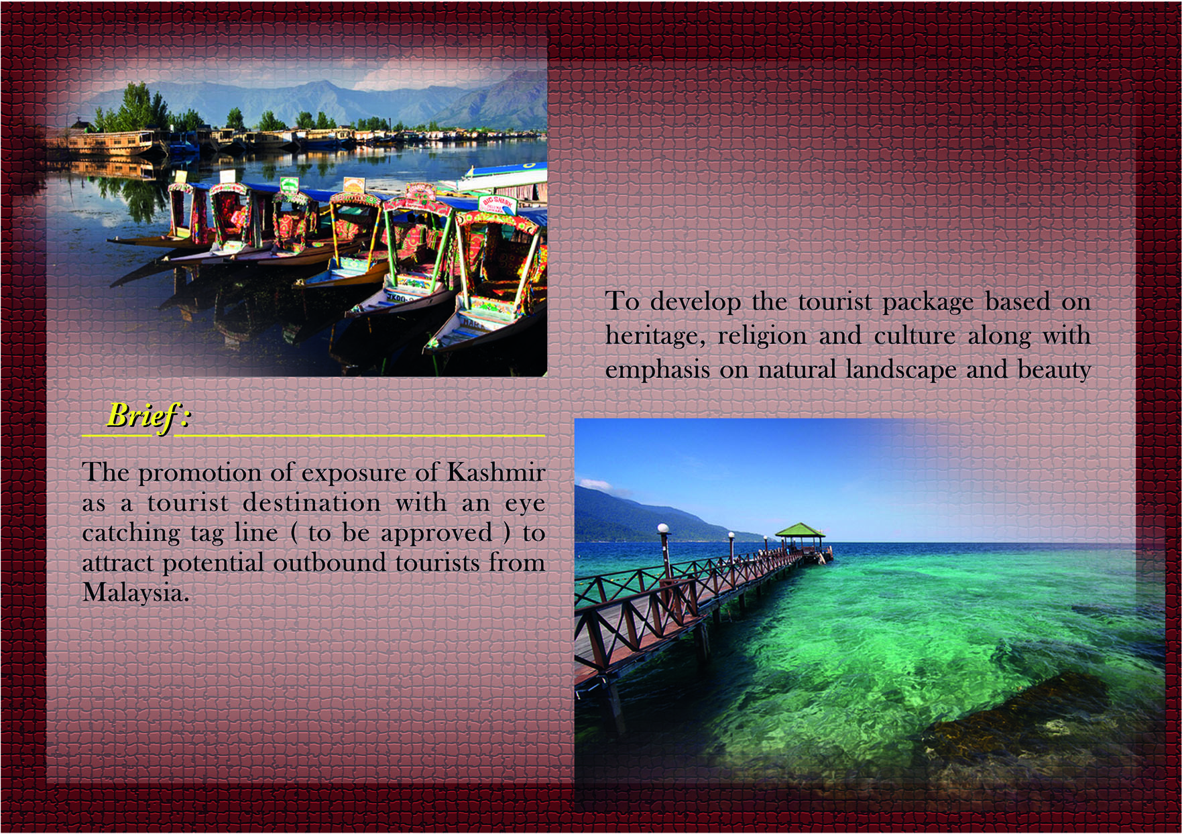

Slide 21
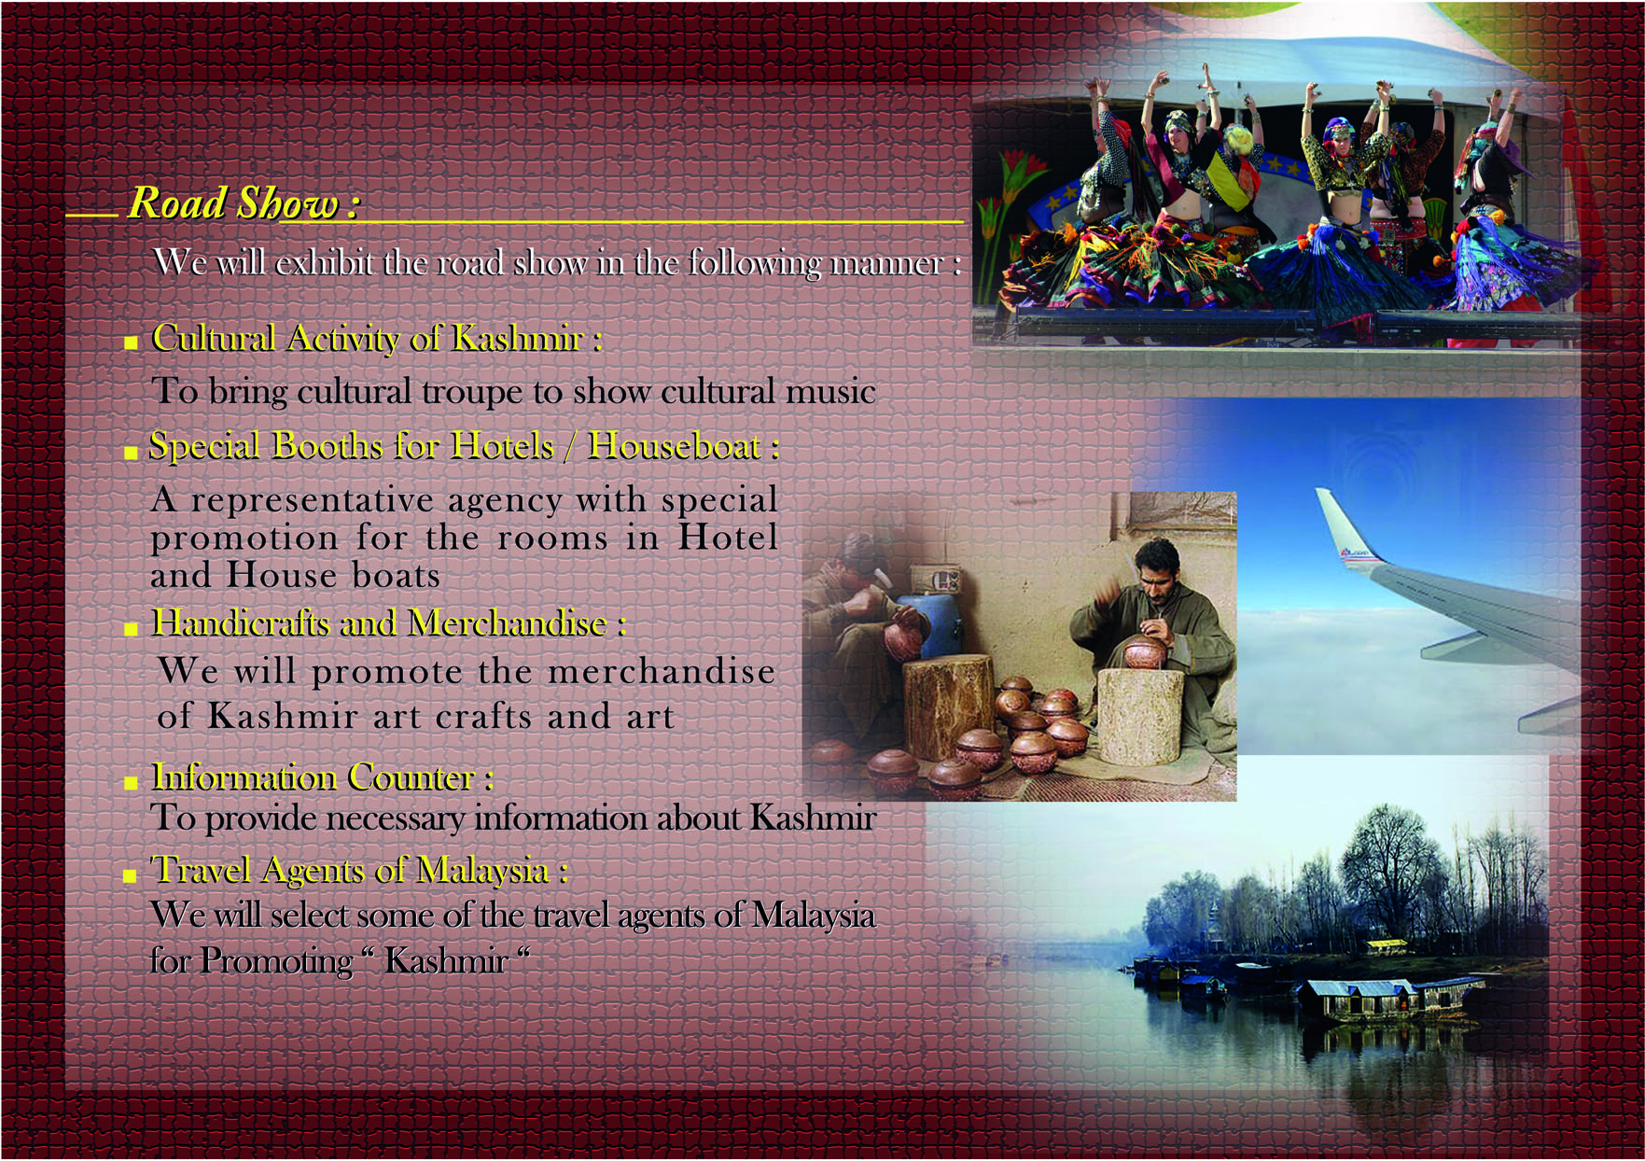

Slide 22
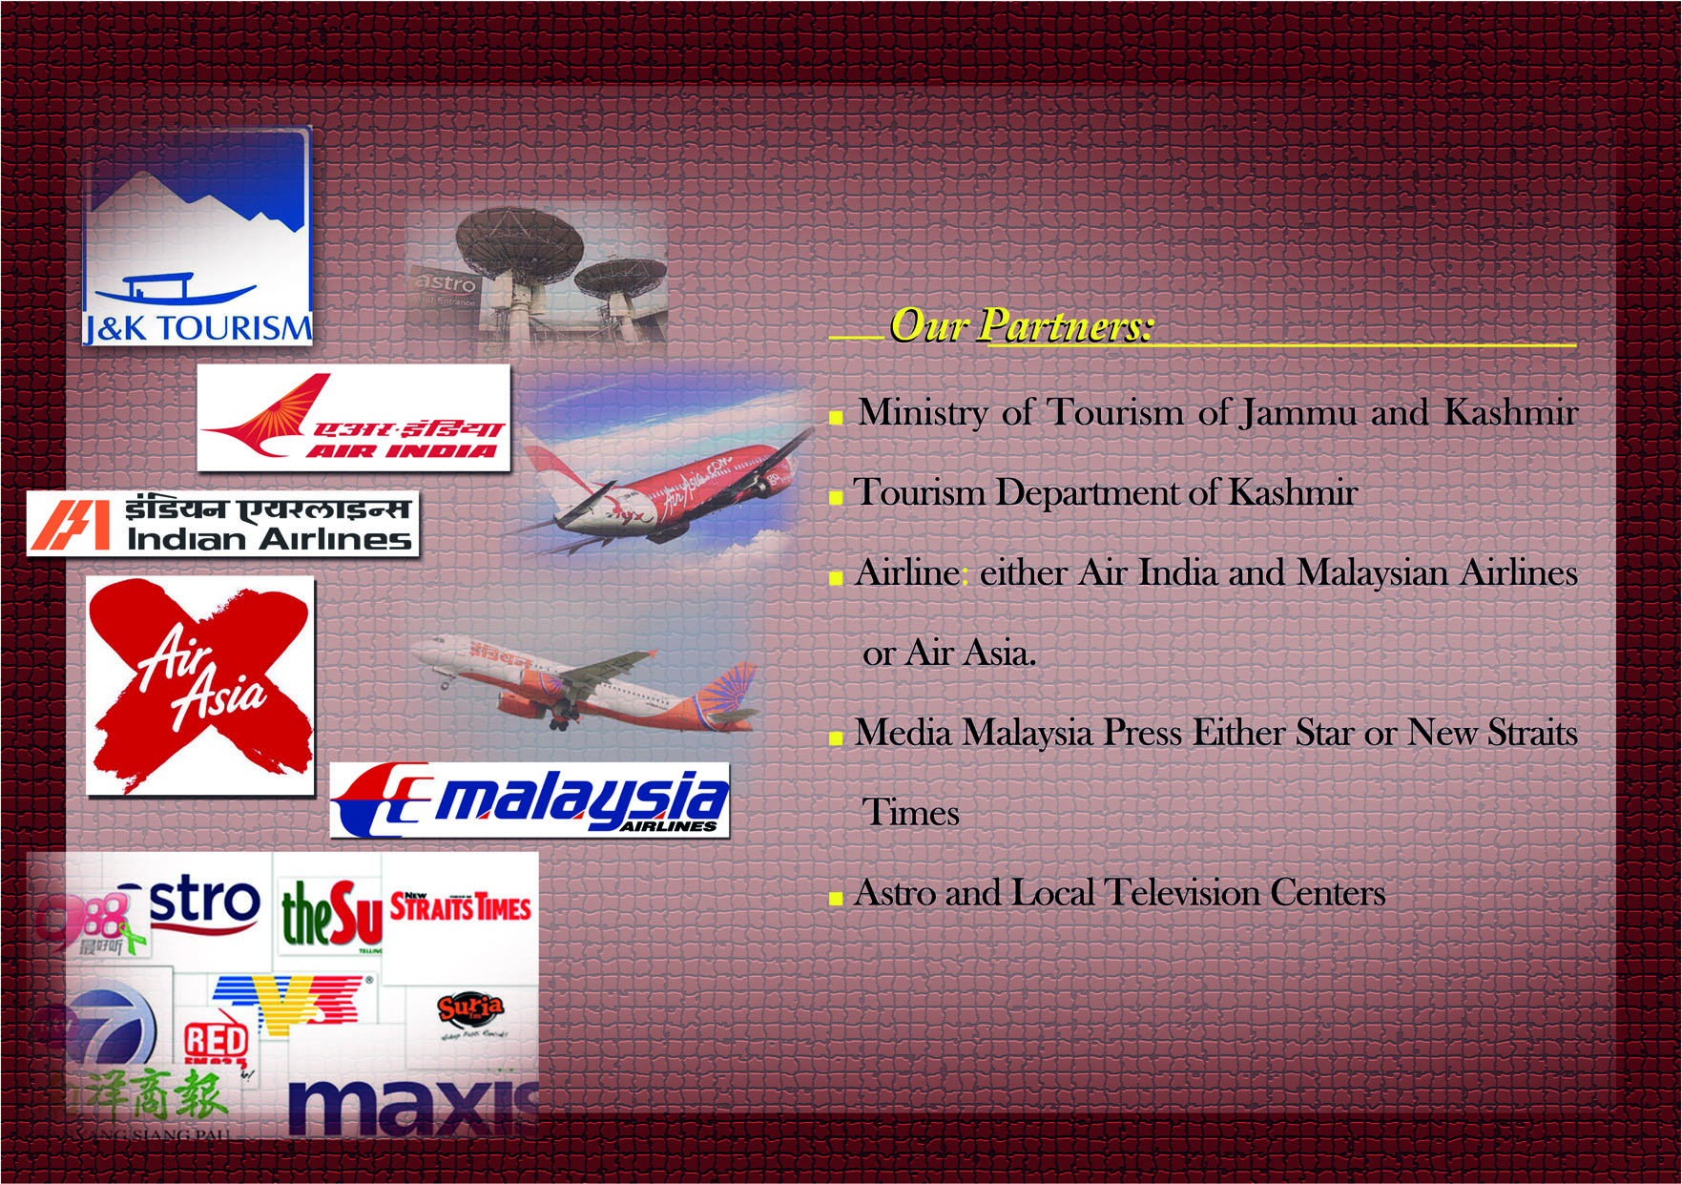

Slide 23
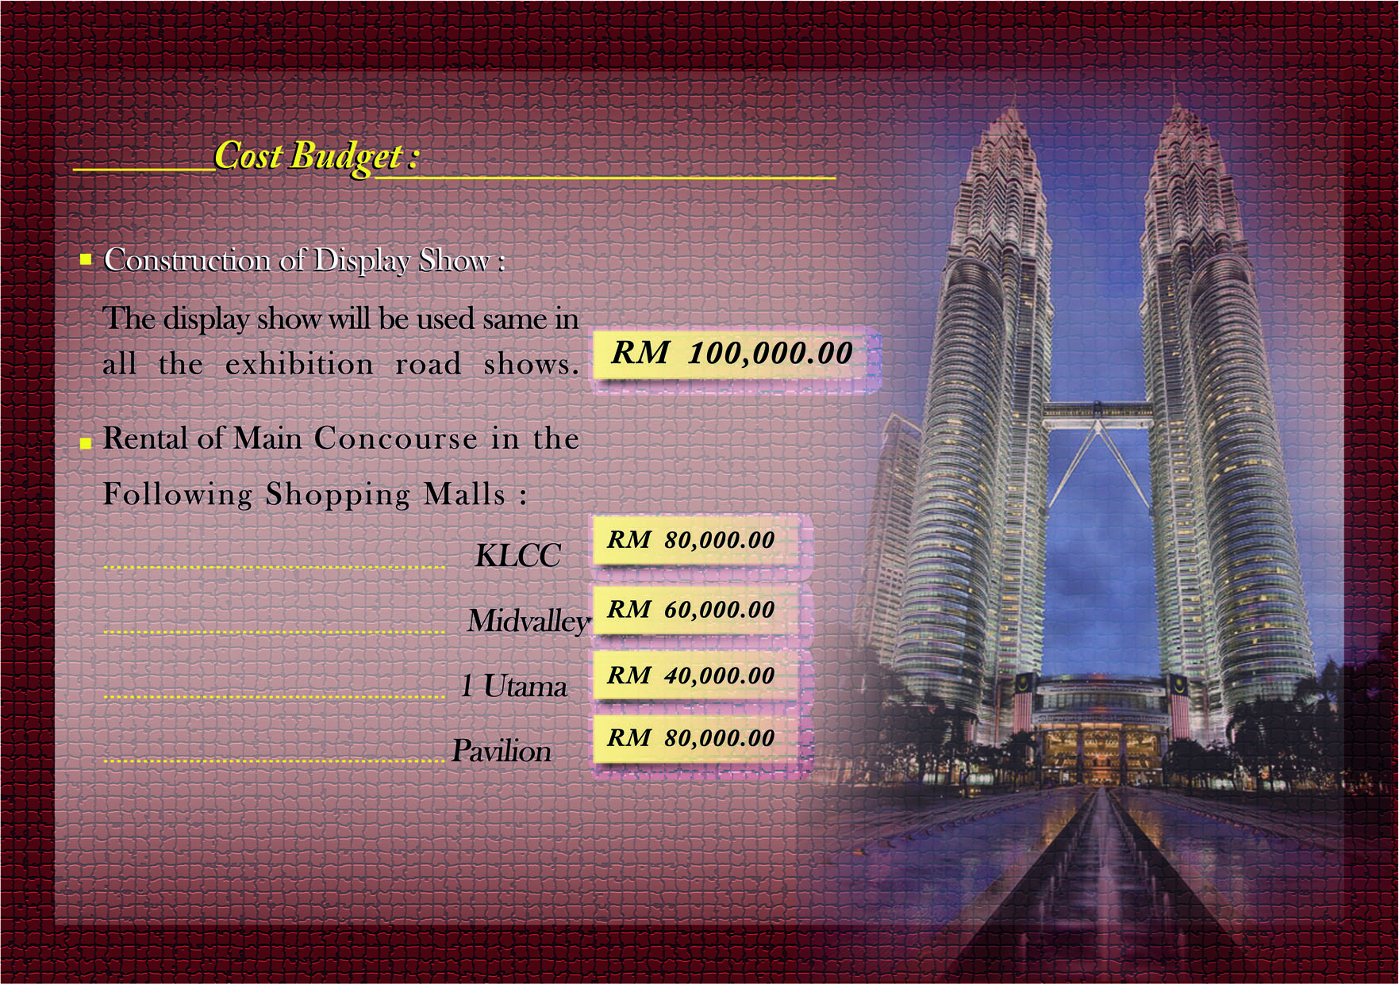

Slide 24
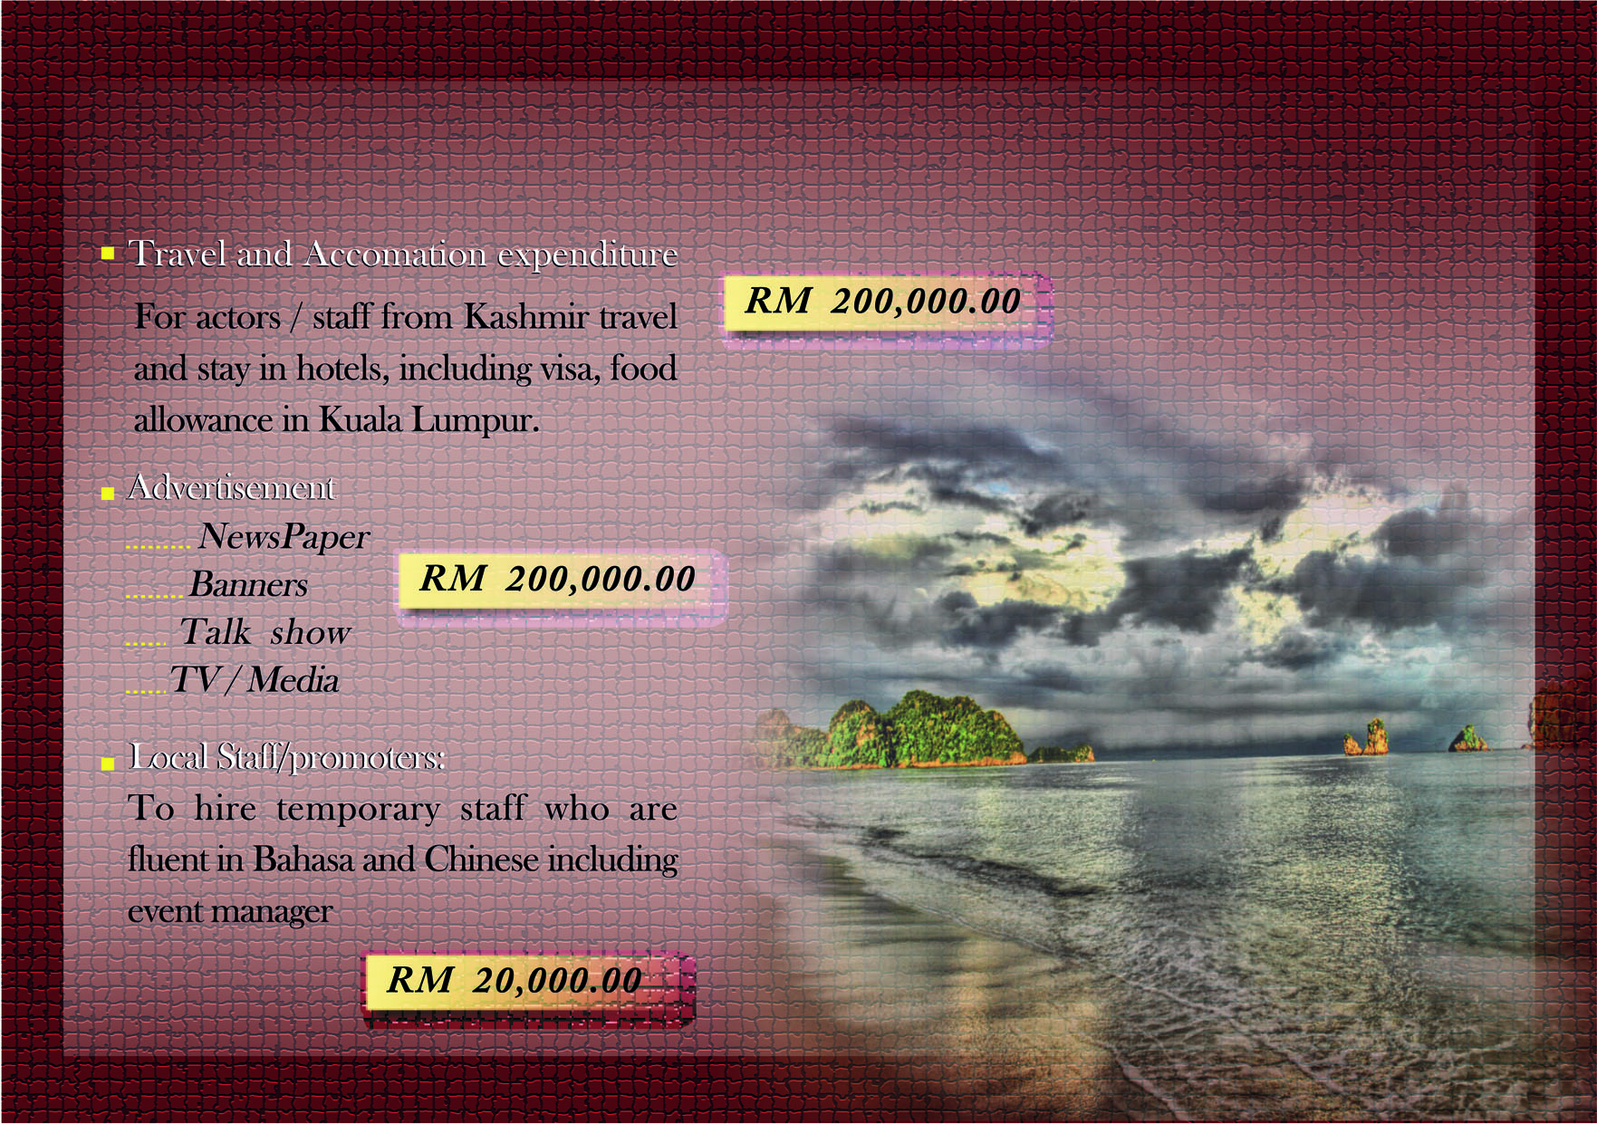

Slide 25


